Slide 1
Motion Capture Hand Postures Data Set
Semester Project Part2
Group #8 Enjam, Siddharth Reddy Chirumamilla, Manoj Kumar Gubba, Vinod Kumar Antony, Shaji

Slide 2
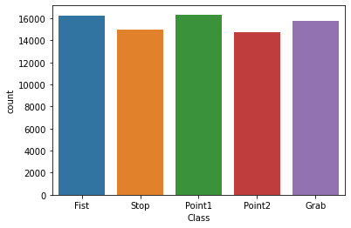
Summary of Project information and Classification of dataset
Data selected: Motion Captured Hand Posture Data Set( MoCap)
Vicon motion captured system
Hand posture type :5 types, 11 markers
Task: Classification
Data Characteristic: Multivariate
Number of Instances:78,095
Number of Attributes: 38
No. of Classes: 5 (Fist, Grab, Stop,
point 1, point 2)
Done the preprocessing of Data and Stored into a CSV file.

Slide 3
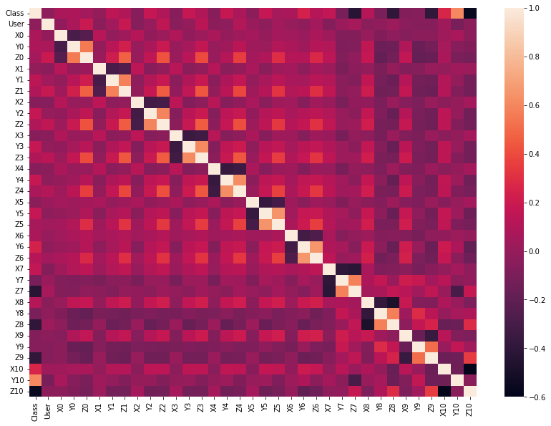
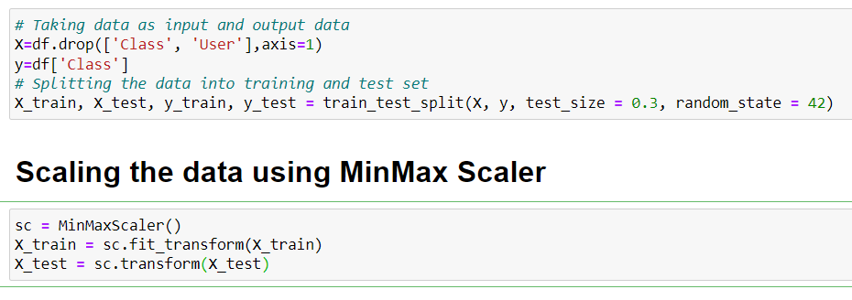
The Correlation Heat Map for the cleaned Data
Models used For Linear Classification
We have performed the following 4 modeling technique for the preprocessed dataset.
Linear Classification 3. Random Forest
KNN 4. Decision Tree
Separating the data to input and output variables X and Y. Splitting the data into train and test set.

Slide 4
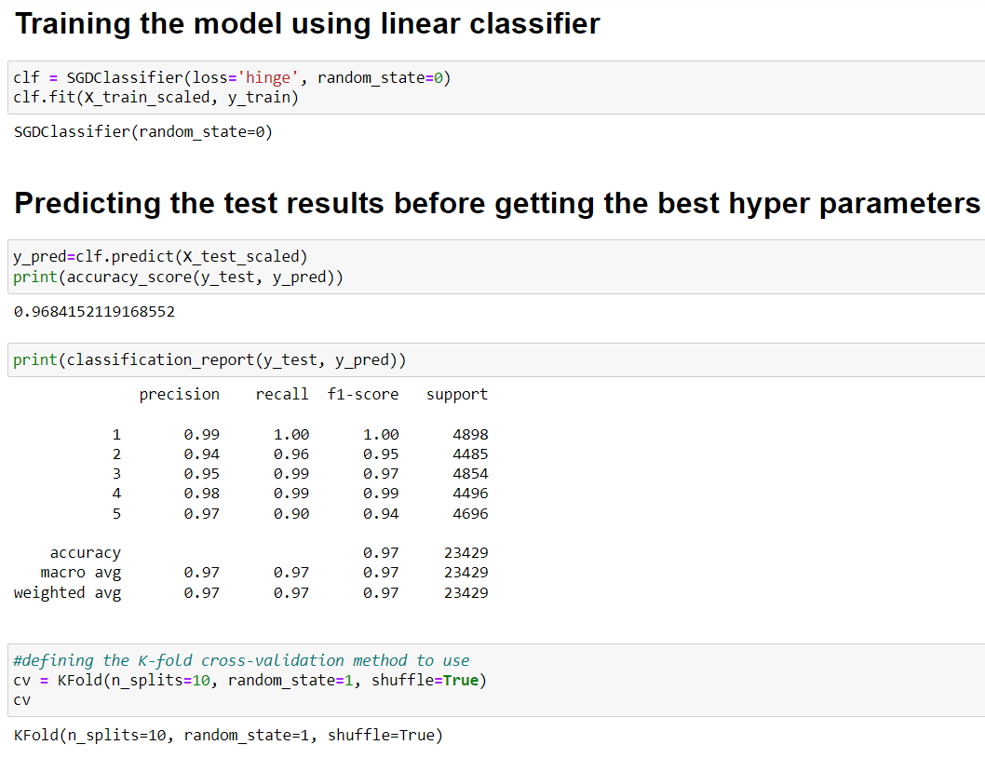
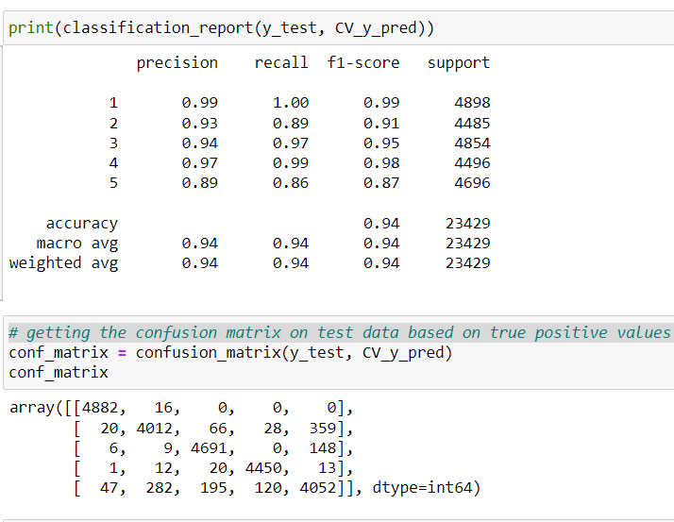
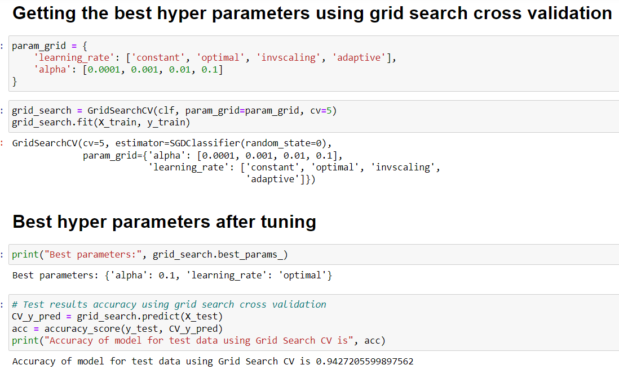
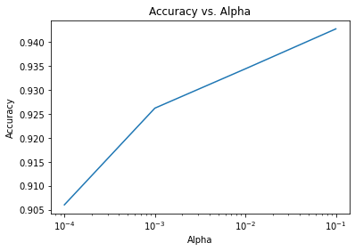
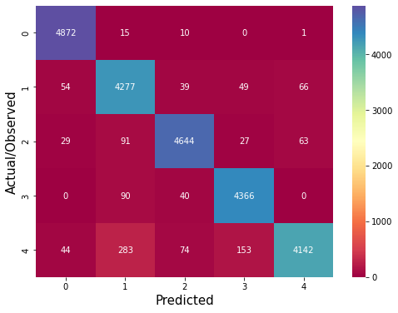
Linear Classification

Slide 5
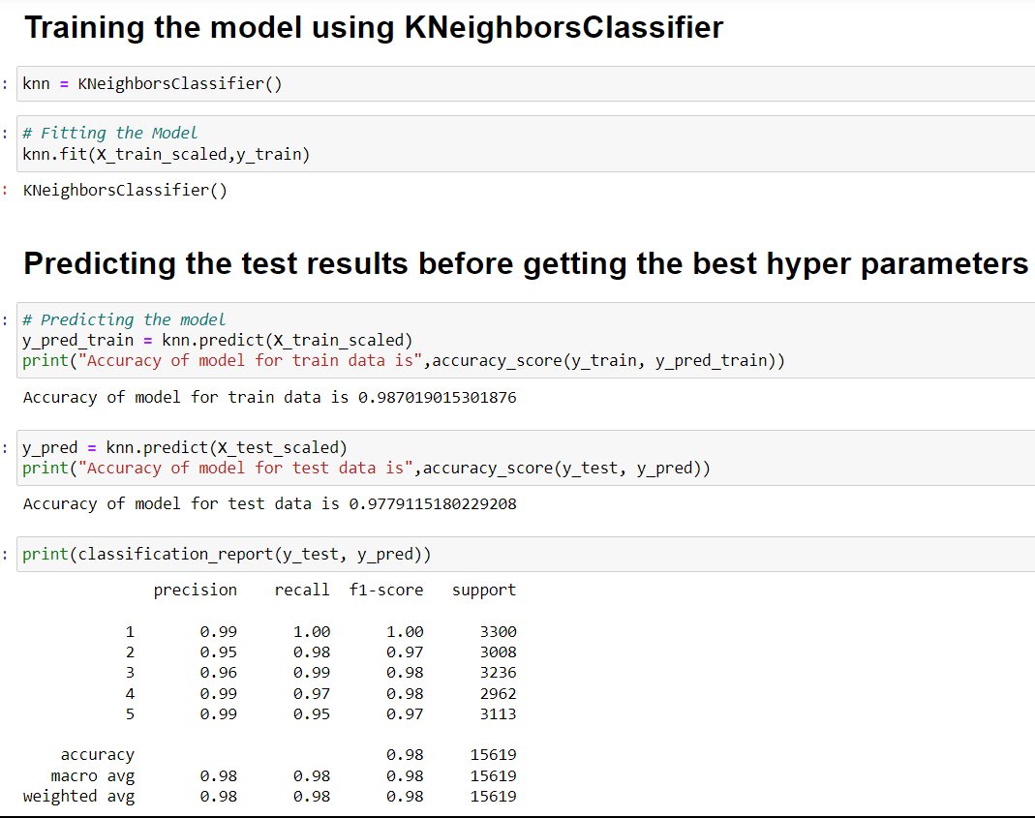
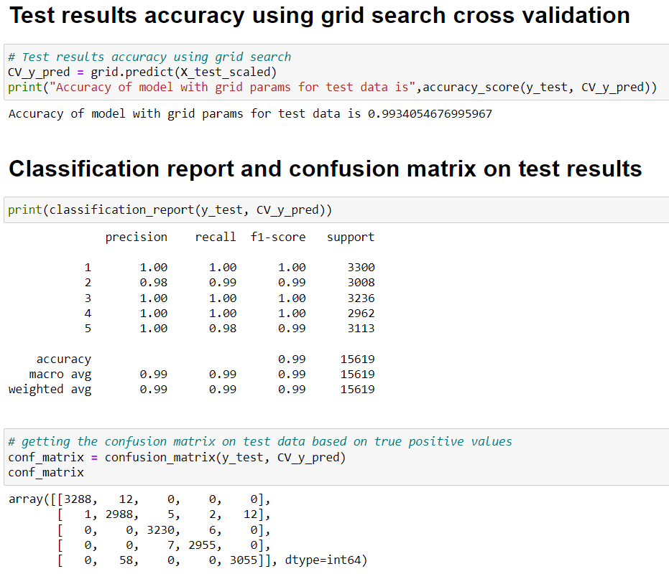
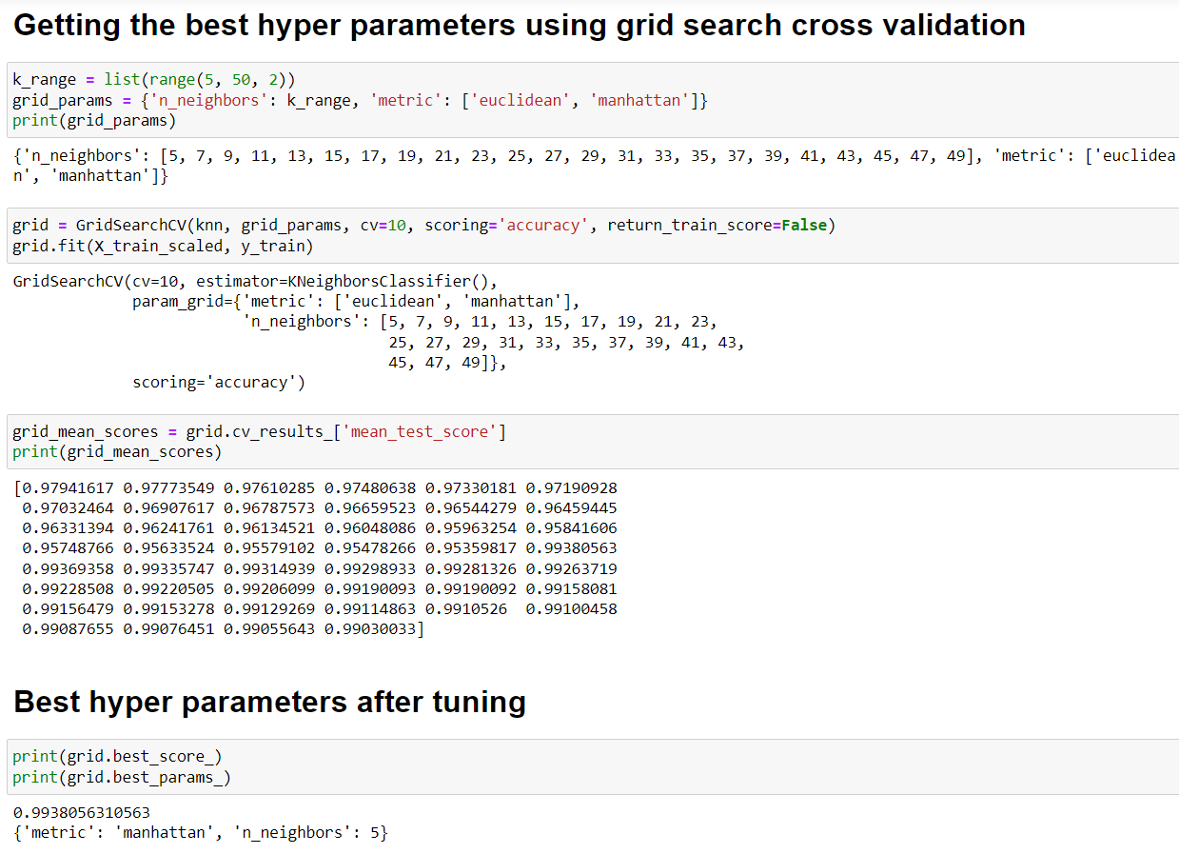
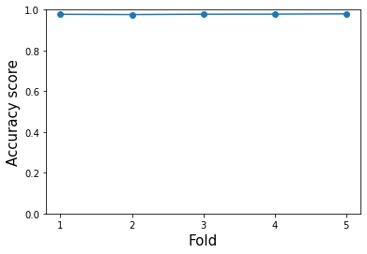
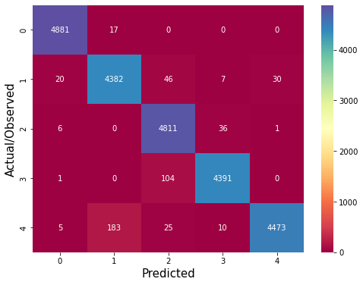
Classification using KNN

Slide 6
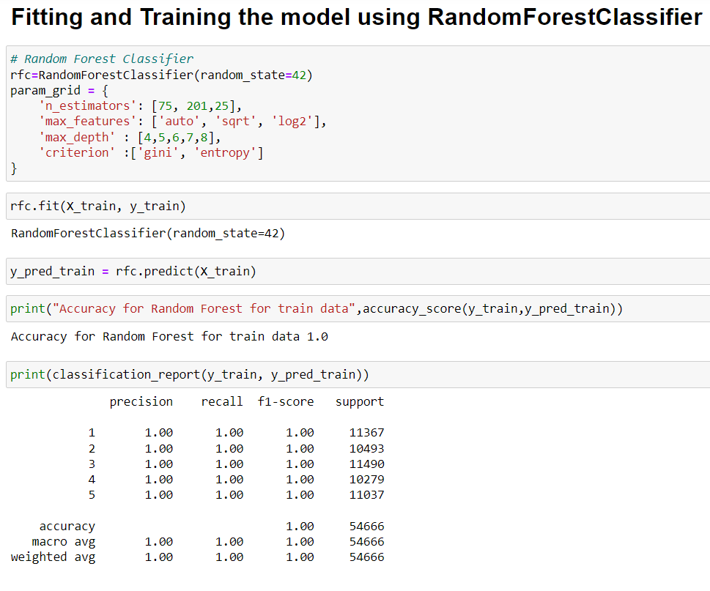
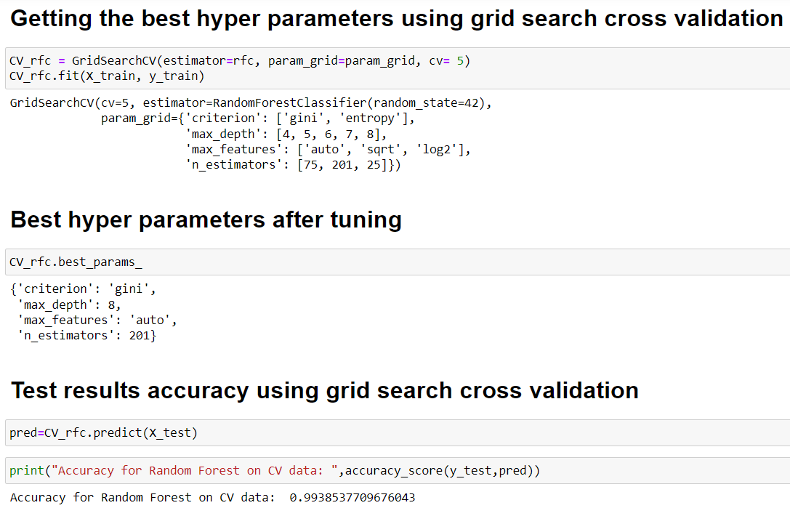
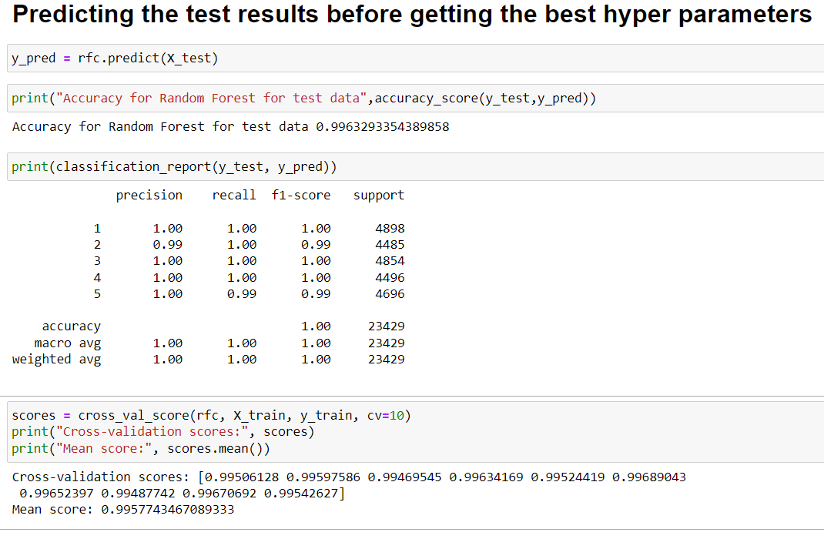
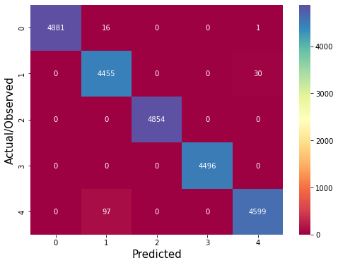
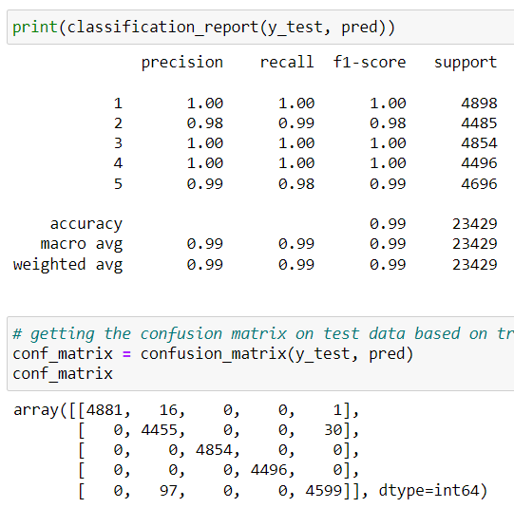
Classification using Random Forest

Slide 7
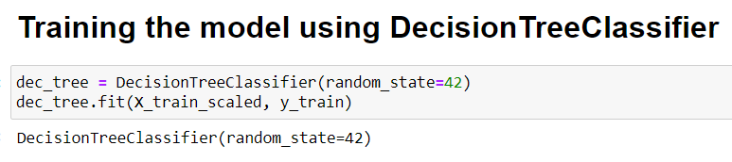
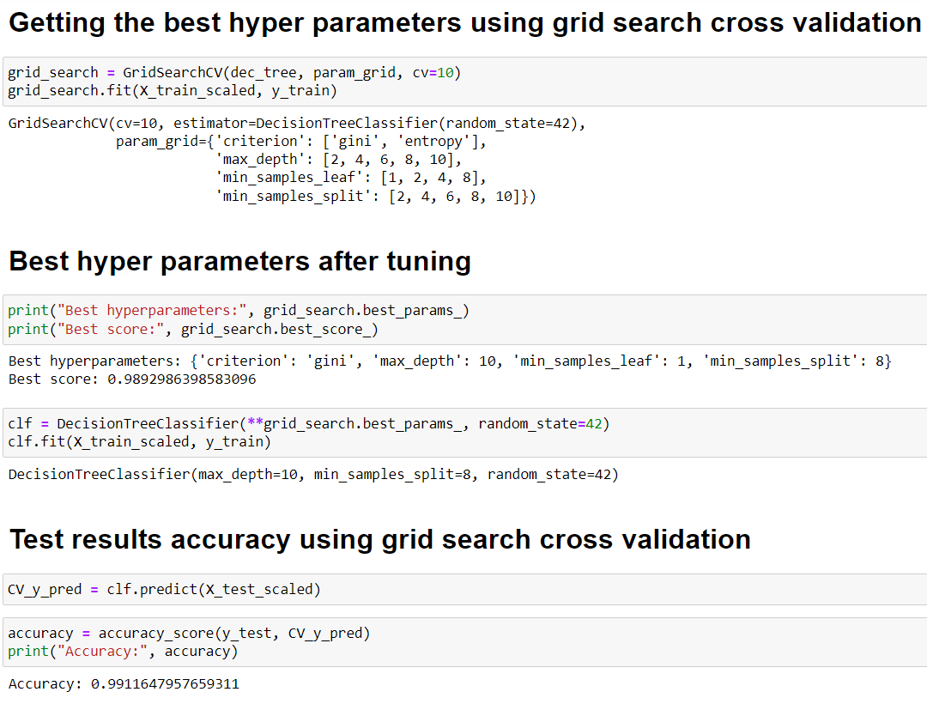
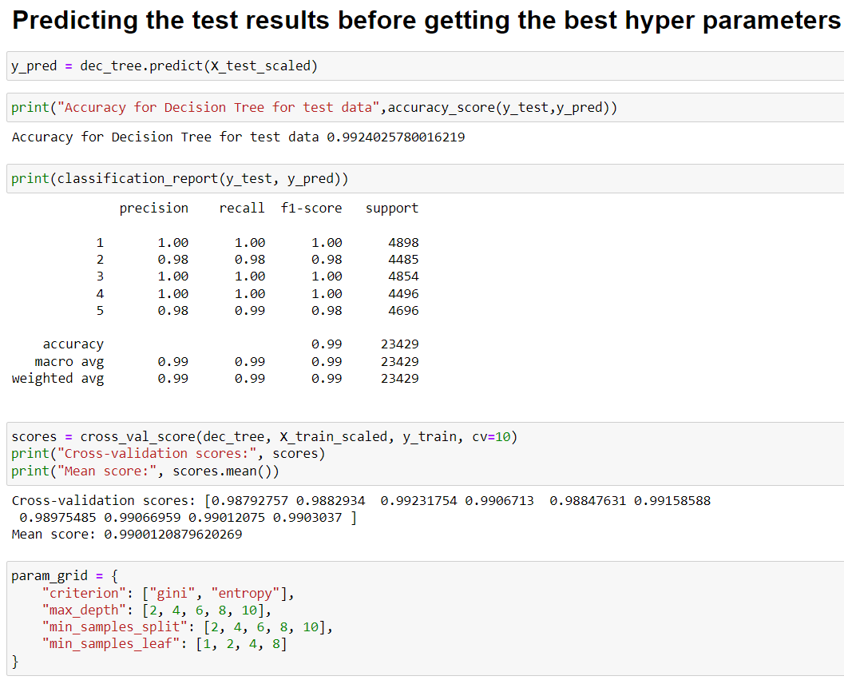
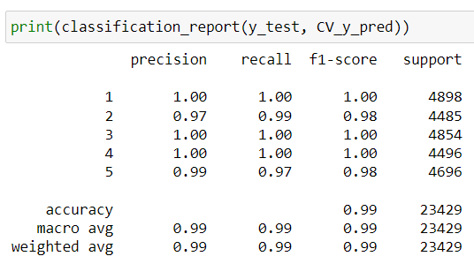
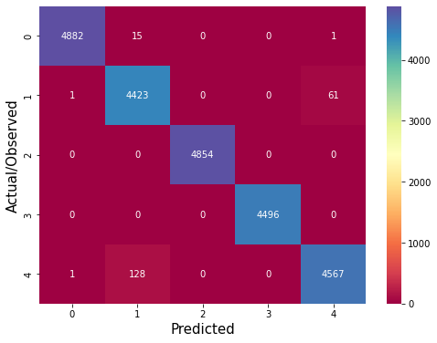
Classification using Decision Tree

Slide 8
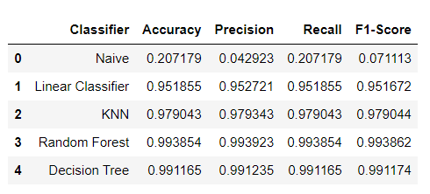
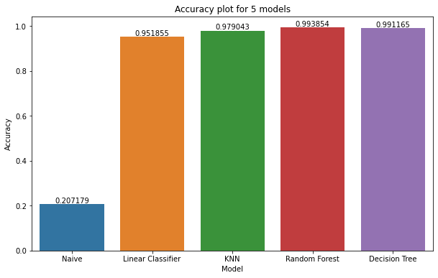
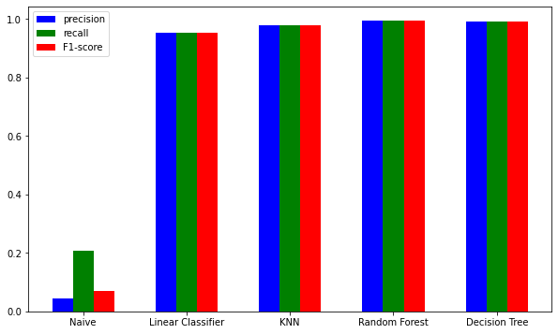

Slide 9
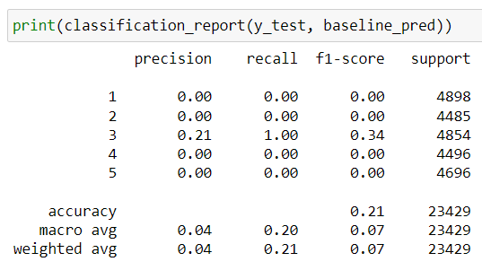
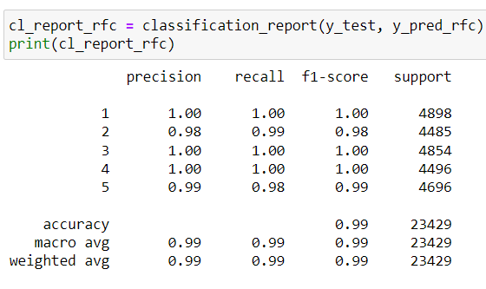
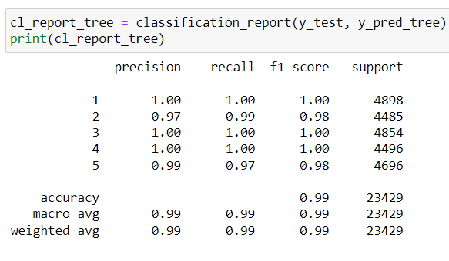
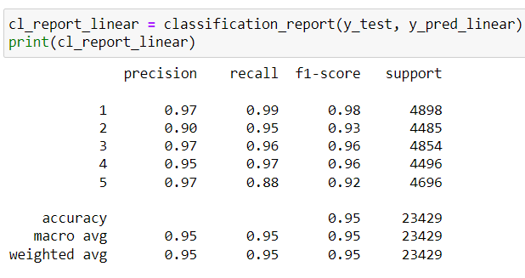
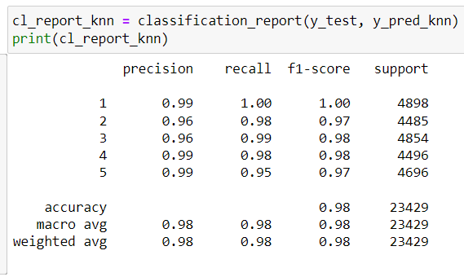
Comparison with Naive and test Results

